Slide 1

Decentralized voting platform Project 3 group 2

Slide 2

AGENDA
Team intro
Motivation for project
Overview of build
Demo
FINAL TAKEAWAYS

Slide 3
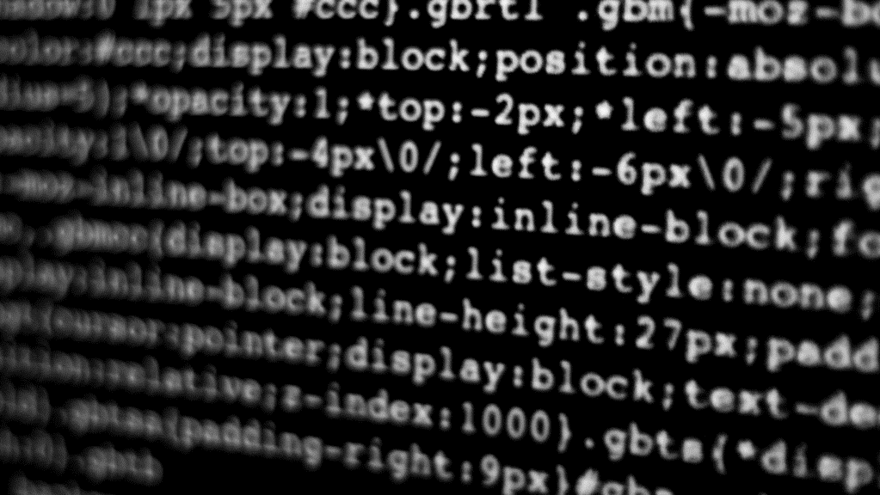
Team intro

Slide 4

Group 2
Alfred Brew – Team Lead
Vishnu Vardhan – Lead Developer
Chris Martin – Product Research
Ravi Yeleswarapu – Sales & Marketing
Serena Shkbari – All round contribution

Slide 5
Motivation

Slide 6
Blockchain and built-in trust
Blockchain is a shared, immutable, and distributed ledger that facilitates the process of recording transactions and tracking assets in a business network.
“Blocks” (containing information) are added to the “Chain” after being verified through a consensus mechanism alleviating the need for a central authority.
Despite no central authority, the mechanism underpinning blockchain technology guarantees:
Tamper proof record keeping promoting trust
Single source of truth despite it’s distributed nature
Enhanced security with efficiency
These characteristics of blockchain make it ideal for voting platforms.
Key concerns such as voter fraud and tampering of vote counts can be prevented via implementing blockchain based ledgers tracking votes on a proposal.

Slide 7
Overview of Build

Slide 8
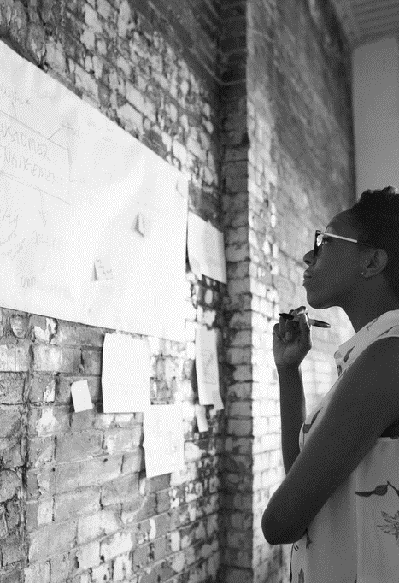
Key FEATUREs
User Authentication: Secure methods for voter registration and authentication.
Proposal Creation: Mechanism for users to create and submit proposals.
Vote Casting: Mechanism for users to cast their votes securely.
Vote Counting: Automated and transparent vote counting.
Result Verification: Publicly verifiable voting results.
Anonymity: Ensuring voter privacy while maintaining vote integrity.
Auditability: Full audit trail for the entire voting process.

Slide 9
TECh Stack and Functionality
Technical Back-end | Functionality
Blockchain (Solidity) | Guts of the smart contract. Includes functions to register a voter, register a proposal, count votes made on proposal, and implement a proposal if vote count is sufficient
Streamlit | Front-end interface to expose voting functions to end users. Displays results of proposal after votes have been cast.
Ganache/Metamask | Wallet and interface with Remix to allow deployment of smart contract and a house for voter addresses

Slide 10
DeMO

Slide 11

THANK YOU
Brita Tamm
502-555-0152
brita@firstupconsultants.com
www.firstupconsultants.com

